Slide 2
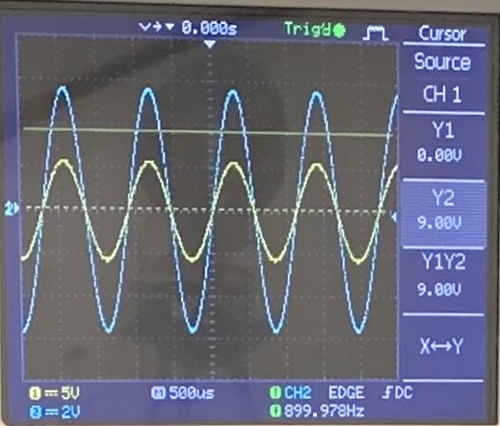
Problem Statement
The responses of a LRC circuit driven by an AC source can be changed by inserting either a non-magnetic metal rod or a ferromagnetic rod into the inductor coil. How can we obtain the magnetic and electric properties of the inserted rod from the circuit’s responses?

Slide 3
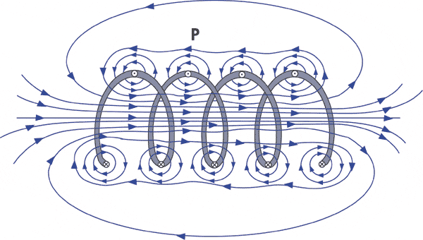
Basic physics
Inductor coil + AC current → changing magnetic field (magnetic induction)
Inserted rod interacts with this field
extra currents generate
magnetic field weakens/strengthens
Properties of the inductor change
Process:
measure the steady-state response of the circuit
circuit theory → acquire the properties of the inductor
electromagnetic theory → calculate the properties of the rod
coil1.gif (600×340) (nde-ed.org)
Notes:
electromagnetic phenomenons happen

Slide 4
I. LRC theory

Slide 5
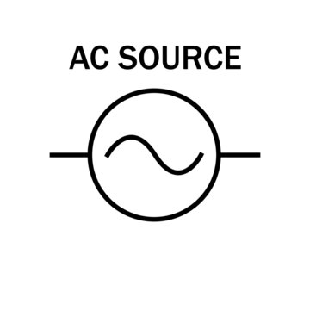
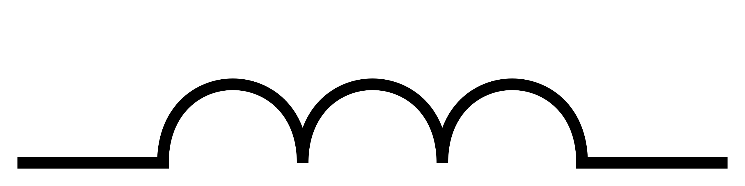
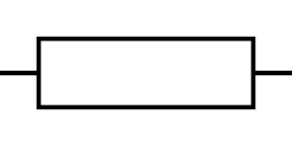
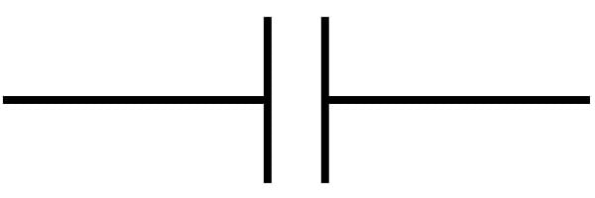
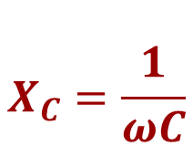
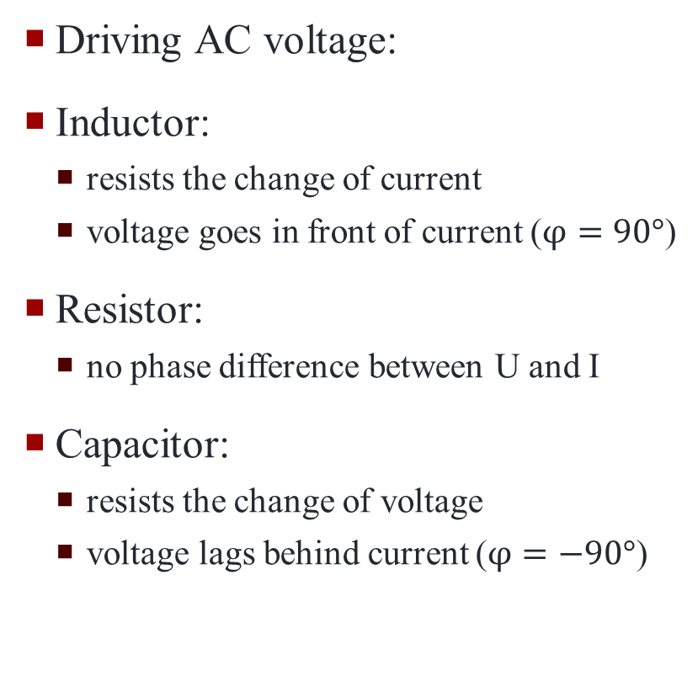
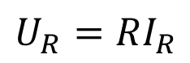
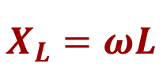
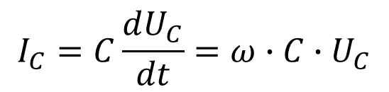
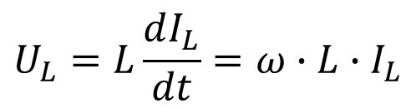
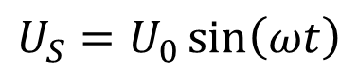
LRC circuit components
Driving AC voltage:
Inductor:
resists the change of current
voltage goes in front of current ($φ=90°$)
Resistor:
no phase difference between U and I
Capacitor:
resists the change of voltage
voltage lags behind current ($φ=−90°$)
$$U_{S}=U_{0}\sin\left(ωt\right)$$
$$U_{L}=L\frac{dI_{L}}{dt}=ω∙L∙I_{L}$$
$$X_{L}=ωL$$
$$U_{R}=RI_{R}$$
$$I_{C}=C\frac{dU_{C}}{dt}=ω∙C∙U_{C}$$
$$X_{C}=\frac{1}{ωC}$$
changes when inserting the rod
Notes:
reactance – resistance-like property

Slide 6
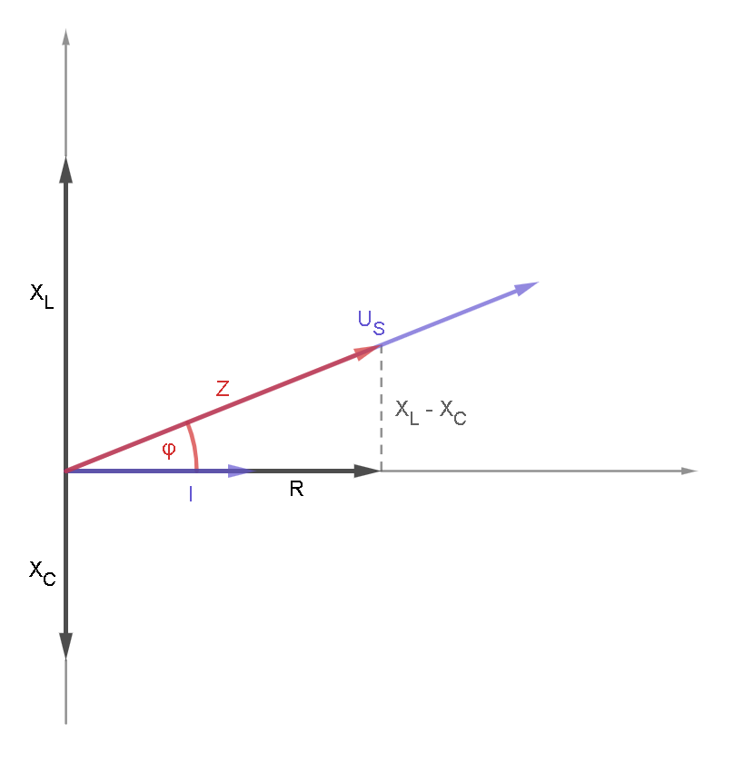
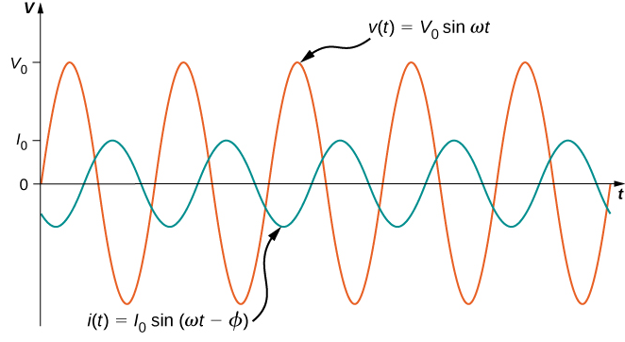
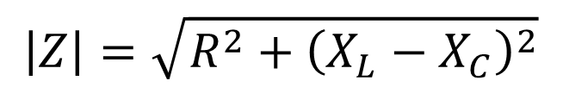
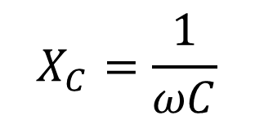
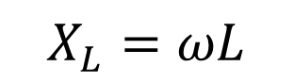
Phasor diagram
Reactance and resistance – phasors
Impedance (vector sum):
φ angle – phase difference between U and I:
$$\left|Z\right|=\sqrt{R^{2}+{\left(X_{L}−X_{C}\right)}^{2}}$$
$$X_{L}=ωL$$
$$X_{C}=\frac{1}{ωC}$$
steady-state response
Notes:
érdekesebb, egyszerűbben érthető legyen, több BASIC physics

Slide 7
II. Measurement setup

Slide 8
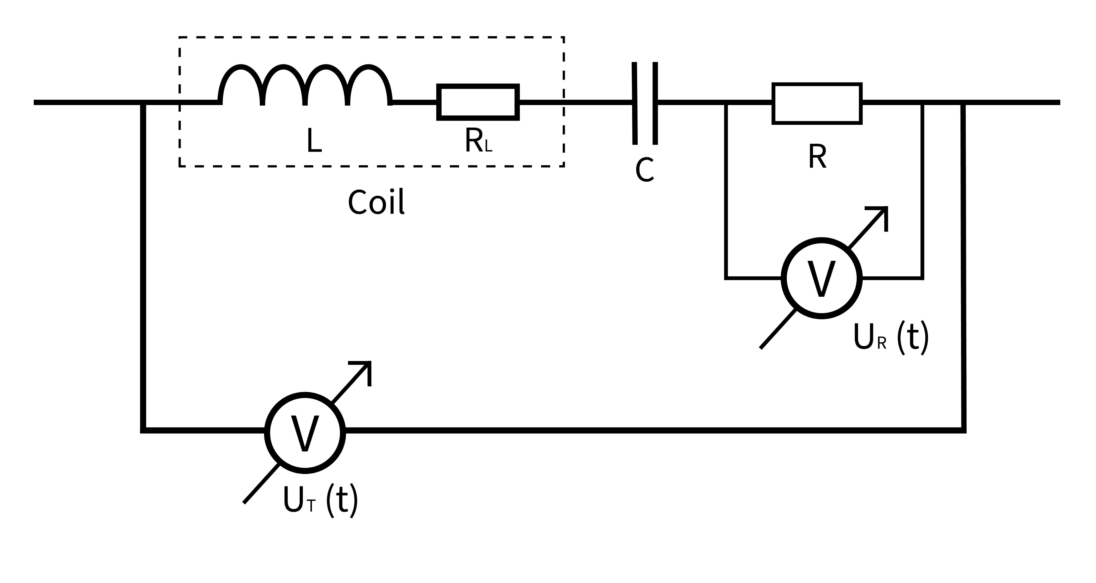
Circuit diagram
changing parameters
S

Slide 9
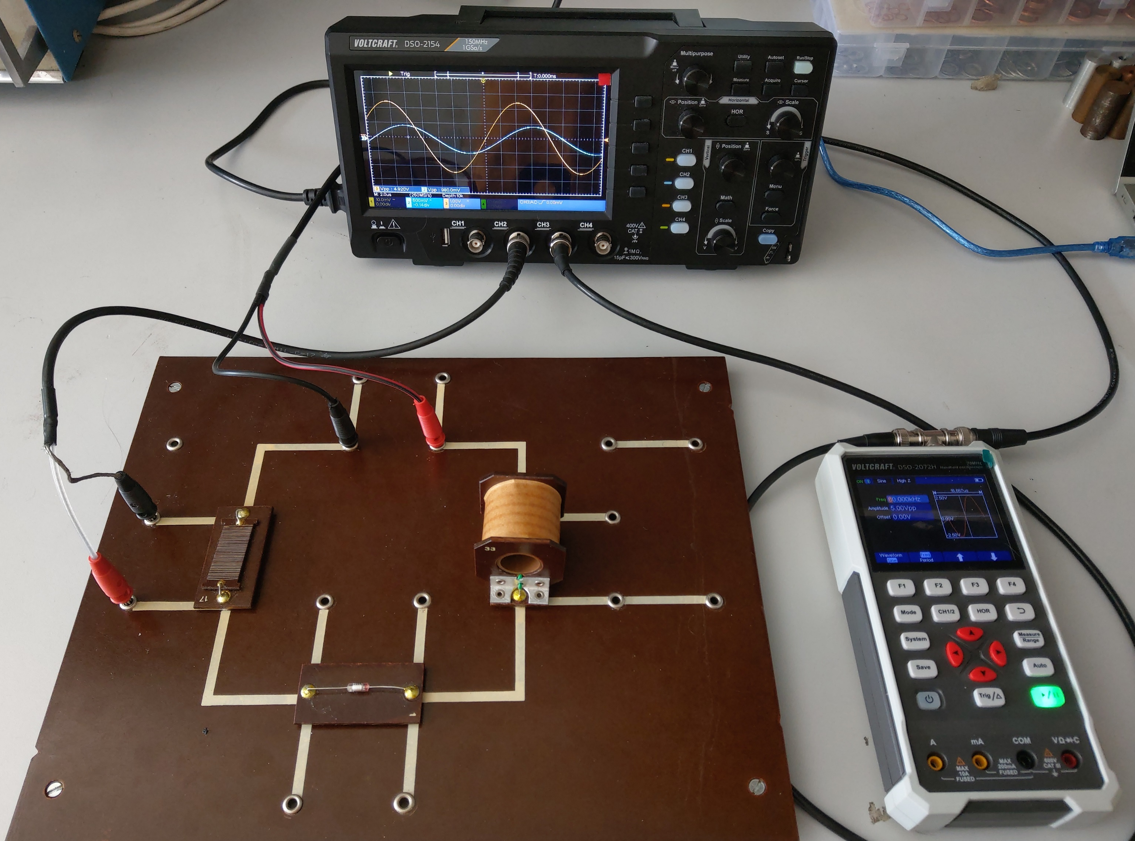
Components and equipment
Inductor:
N = 1200
L₀ = 0.028 H
R₀ = 16.4 Ω
l = 5 cm
d = 1.9 cm
C = 272 pF
R = 289 Ω
U = 2.5 V pk-pk (sinusoidal)
Notes:
több kondi és elllenállás

Slide 10
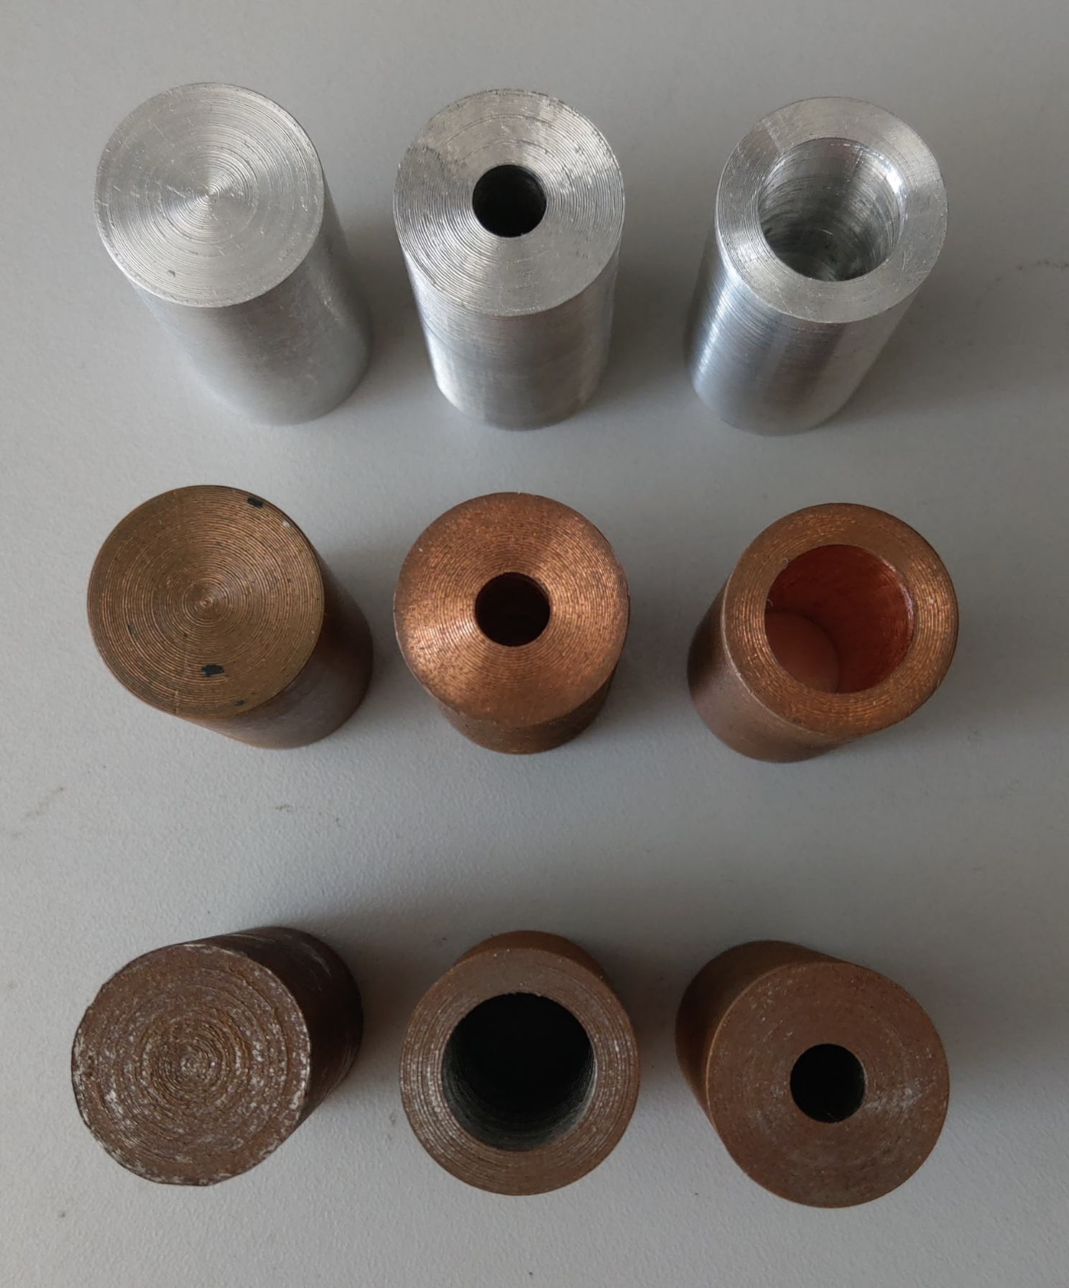
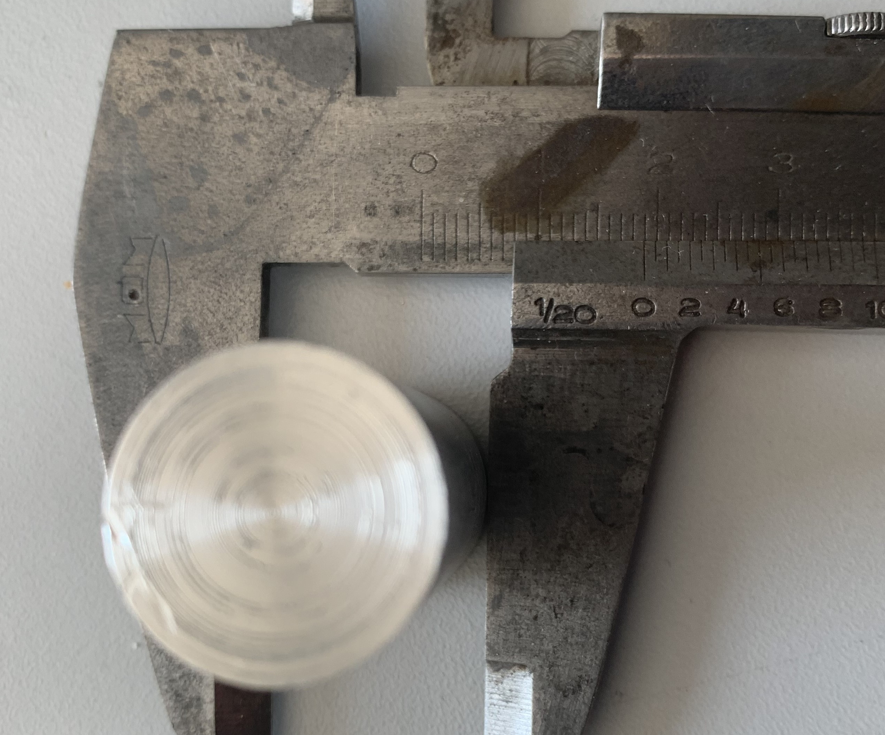
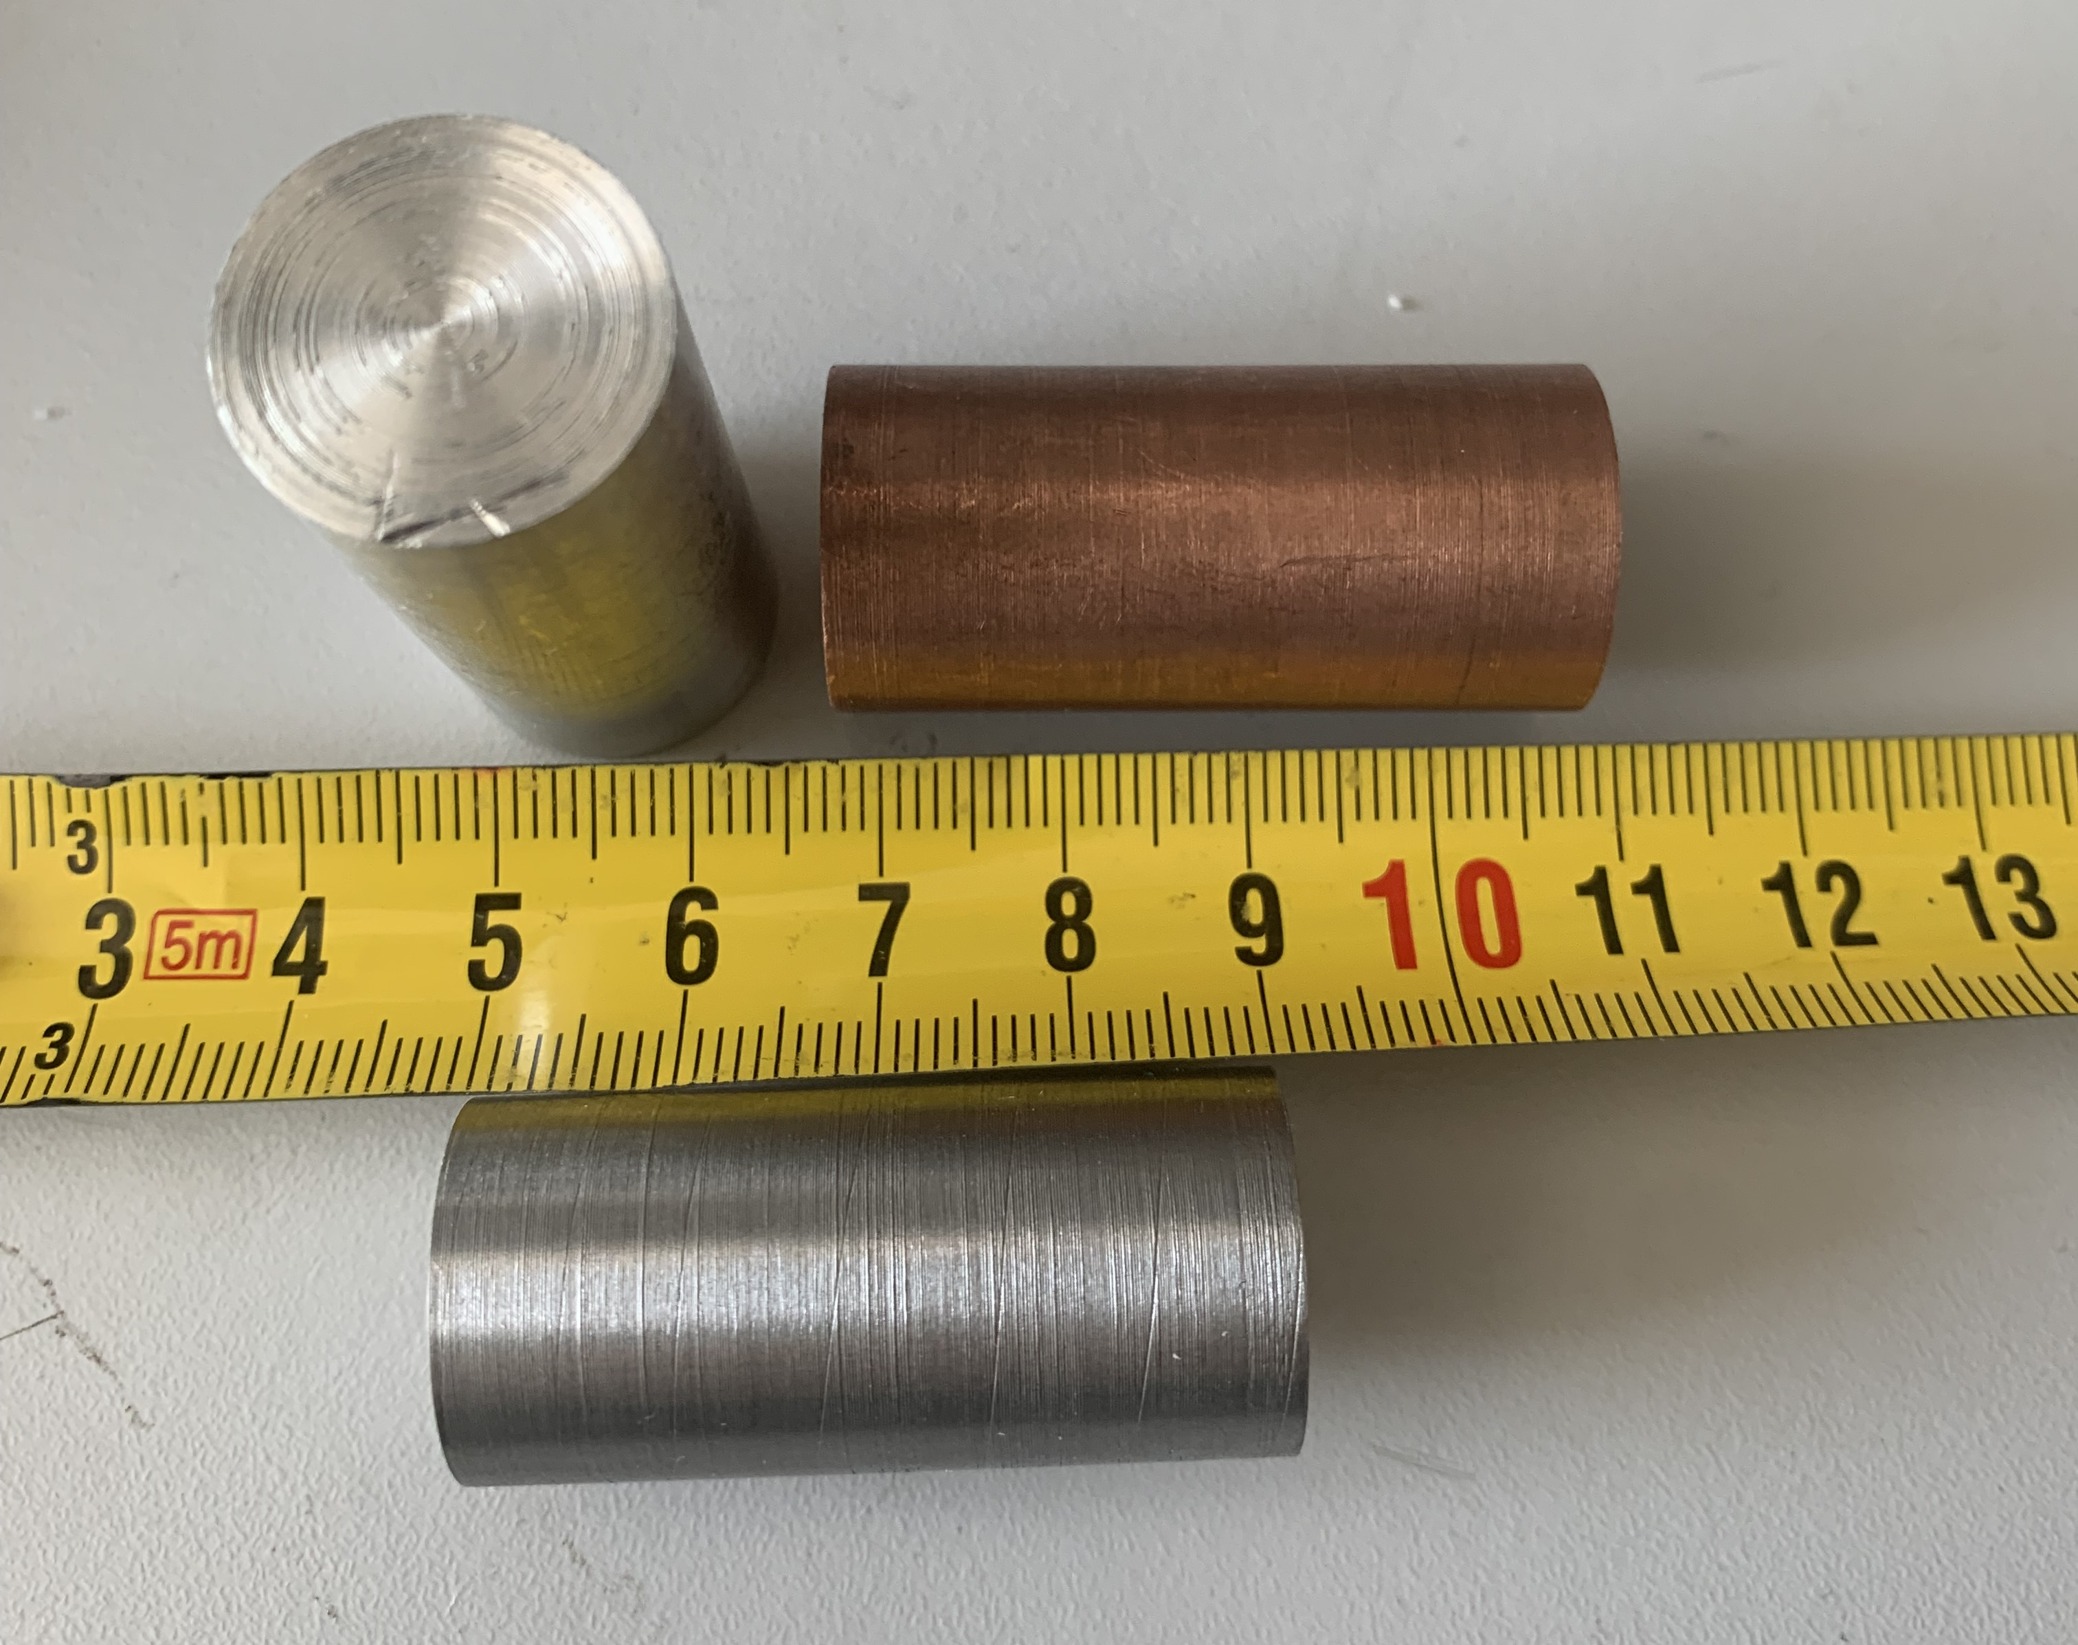
Rods
Rod materials:
Aluminium (Al)
Copper (Cu)
Iron (Fe)
Holes inside the rods
non-magnetic conductors
ferromagnetic

Slide 11
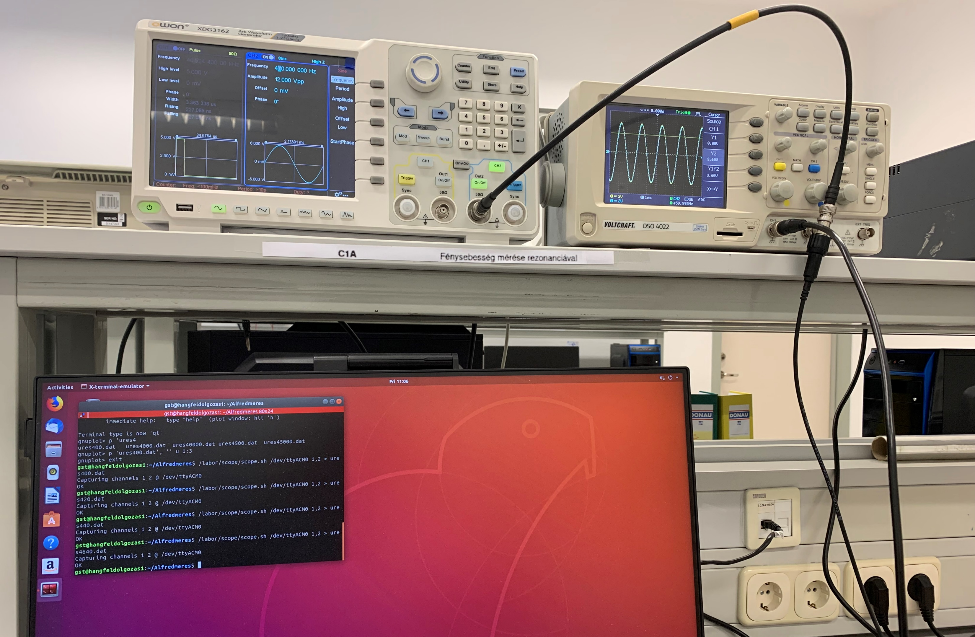
Instruments
XDG 3162 Function generator
DSO 4022 Oscilloscope

Slide 12
III. Experiments, evaluation

Slide 13
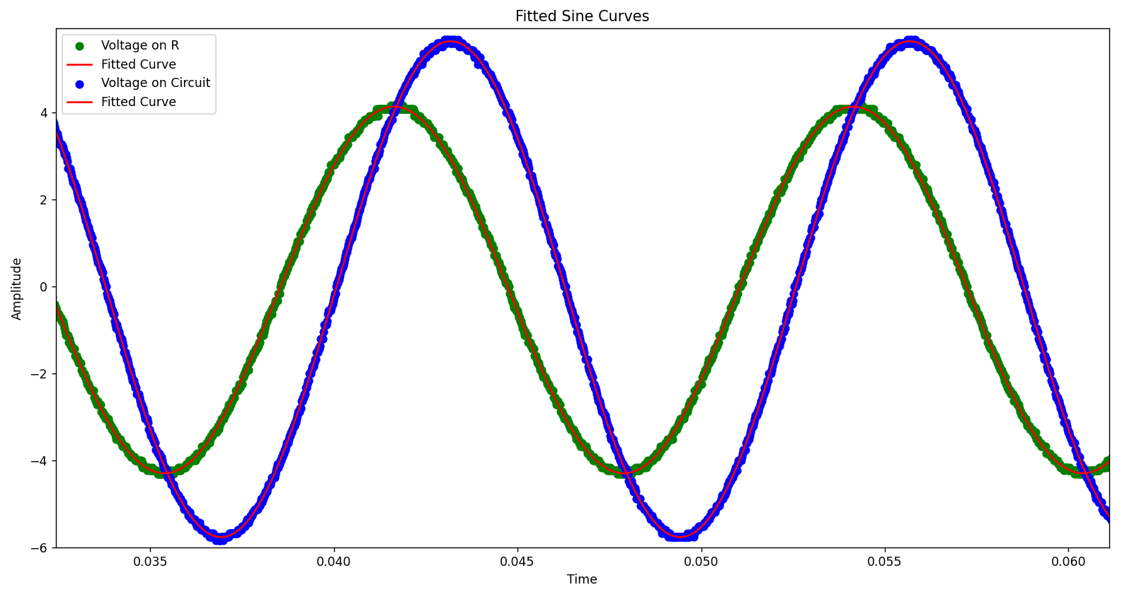
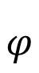
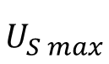
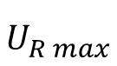
Measured sine waves
$$U_{S max}$$
$$φ$$
$$U_{R max}$$
Notes:
measured through a frequency spectrum

Slide 14
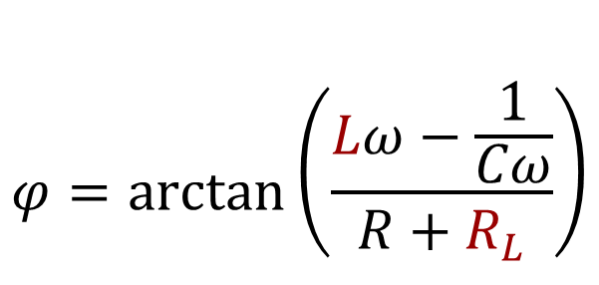
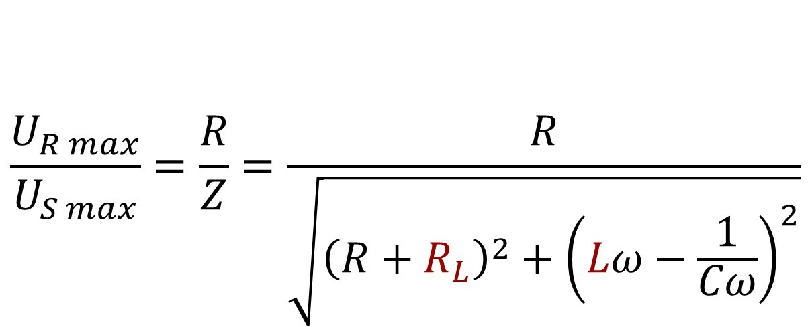
Equations – simple LRC theory
$$\frac{U_{R max}}{U_{S max}}=\frac{R}{Z}=\frac{R}{\sqrt{{\left(R+R_{L}\right)}^{2}+{\left(Lω−\frac{1}{Cω}\right)}^{2}}}$$
Ohm’s law
$$φ=arctan⁡\left(\frac{Lω−\frac{1}{Cω}}{R+R_{L}}\right)$$
geometry

Slide 15
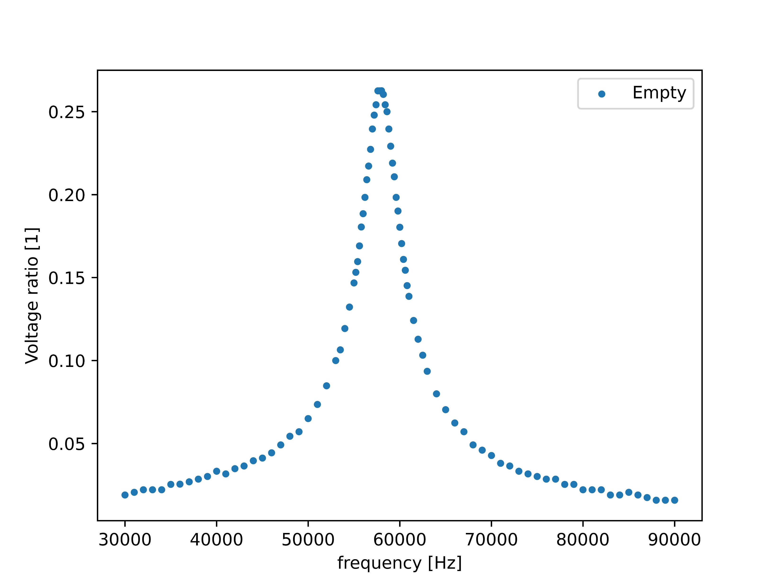
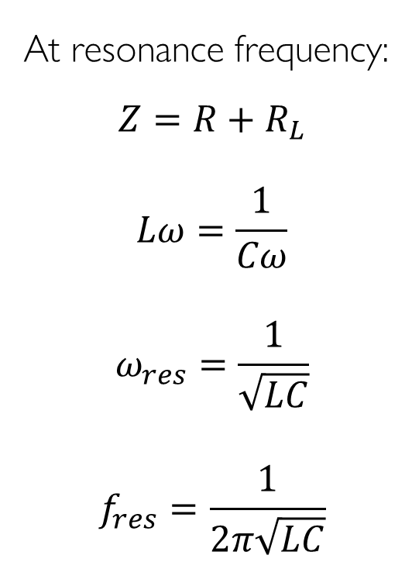
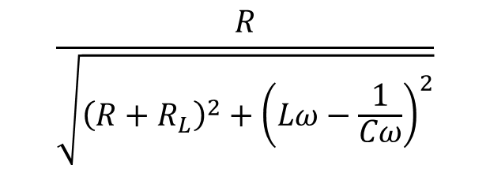
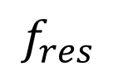
Fit on voltage ratio – empty coil
At resonance frequency:
$$Z=R+R_{L}$$
$$Lω=\frac{1}{Cω}$$
$$ω_{res}=\frac{1}{\sqrt{LC}}$$
$$f_{res}=\frac{1}{2π\sqrt{LC}}$$
$$\frac{R}{\sqrt{{\left(R+R_{L}\right)}^{2}+{\left(Lω−\frac{1}{Cω}\right)}^{2}}}$$
$$f_{res}$$
Notes:
R-hez nem hozzáadni az R0-t !!! – jobban fittel ?

Slide 16
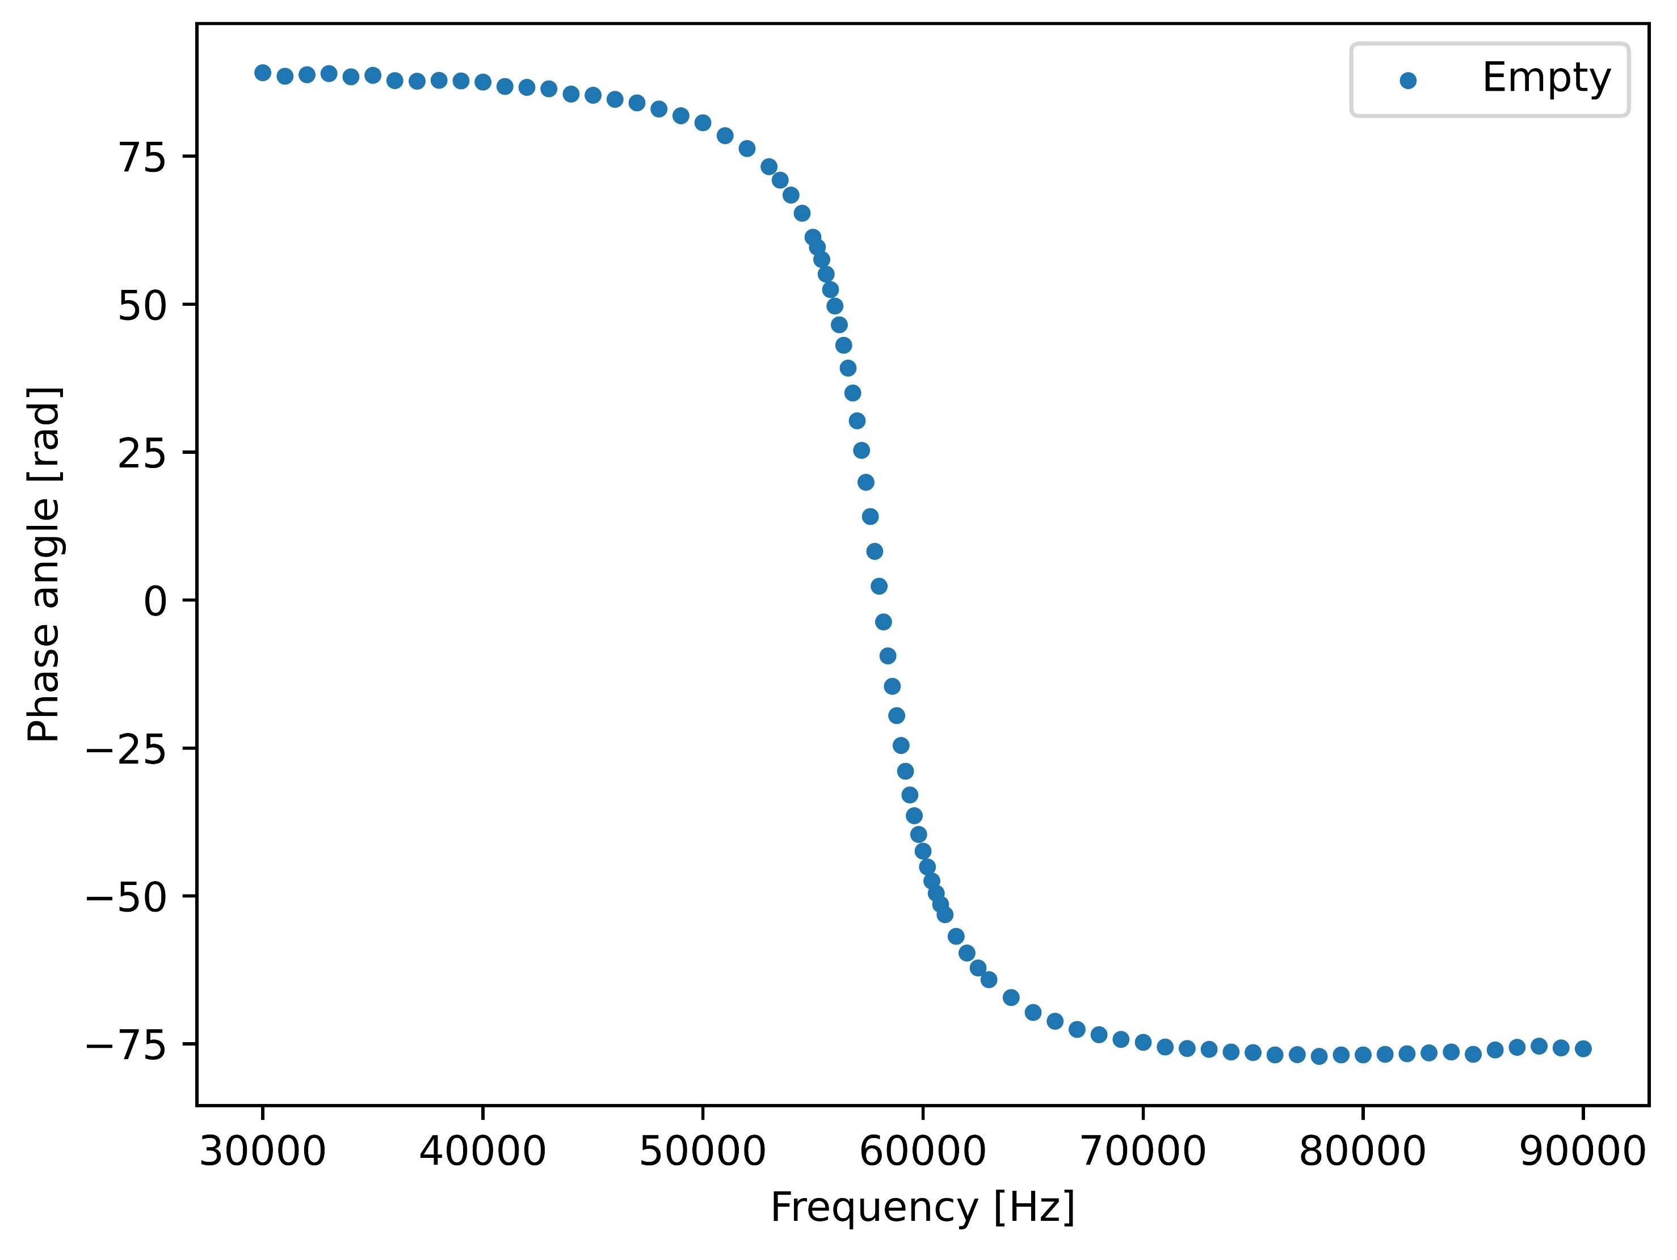
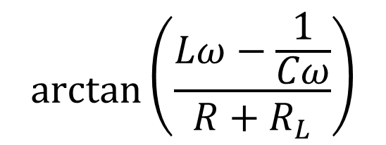

Phase angle
$$arctan⁡\left(\frac{Lω−\frac{1}{Cω}}{R+R_{L}}\right)$$
$$f_{res}$$
Notes:
the resonance frequency is the same

Slide 17
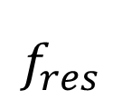
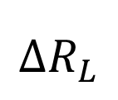
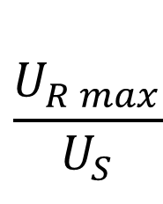
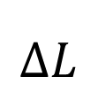
Change of L and R_{L}
$$\frac{U_{R max}}{U_{S}}$$
$$∆R_{L}$$
$$∆L$$
$$f_{res}$$

Slide 18
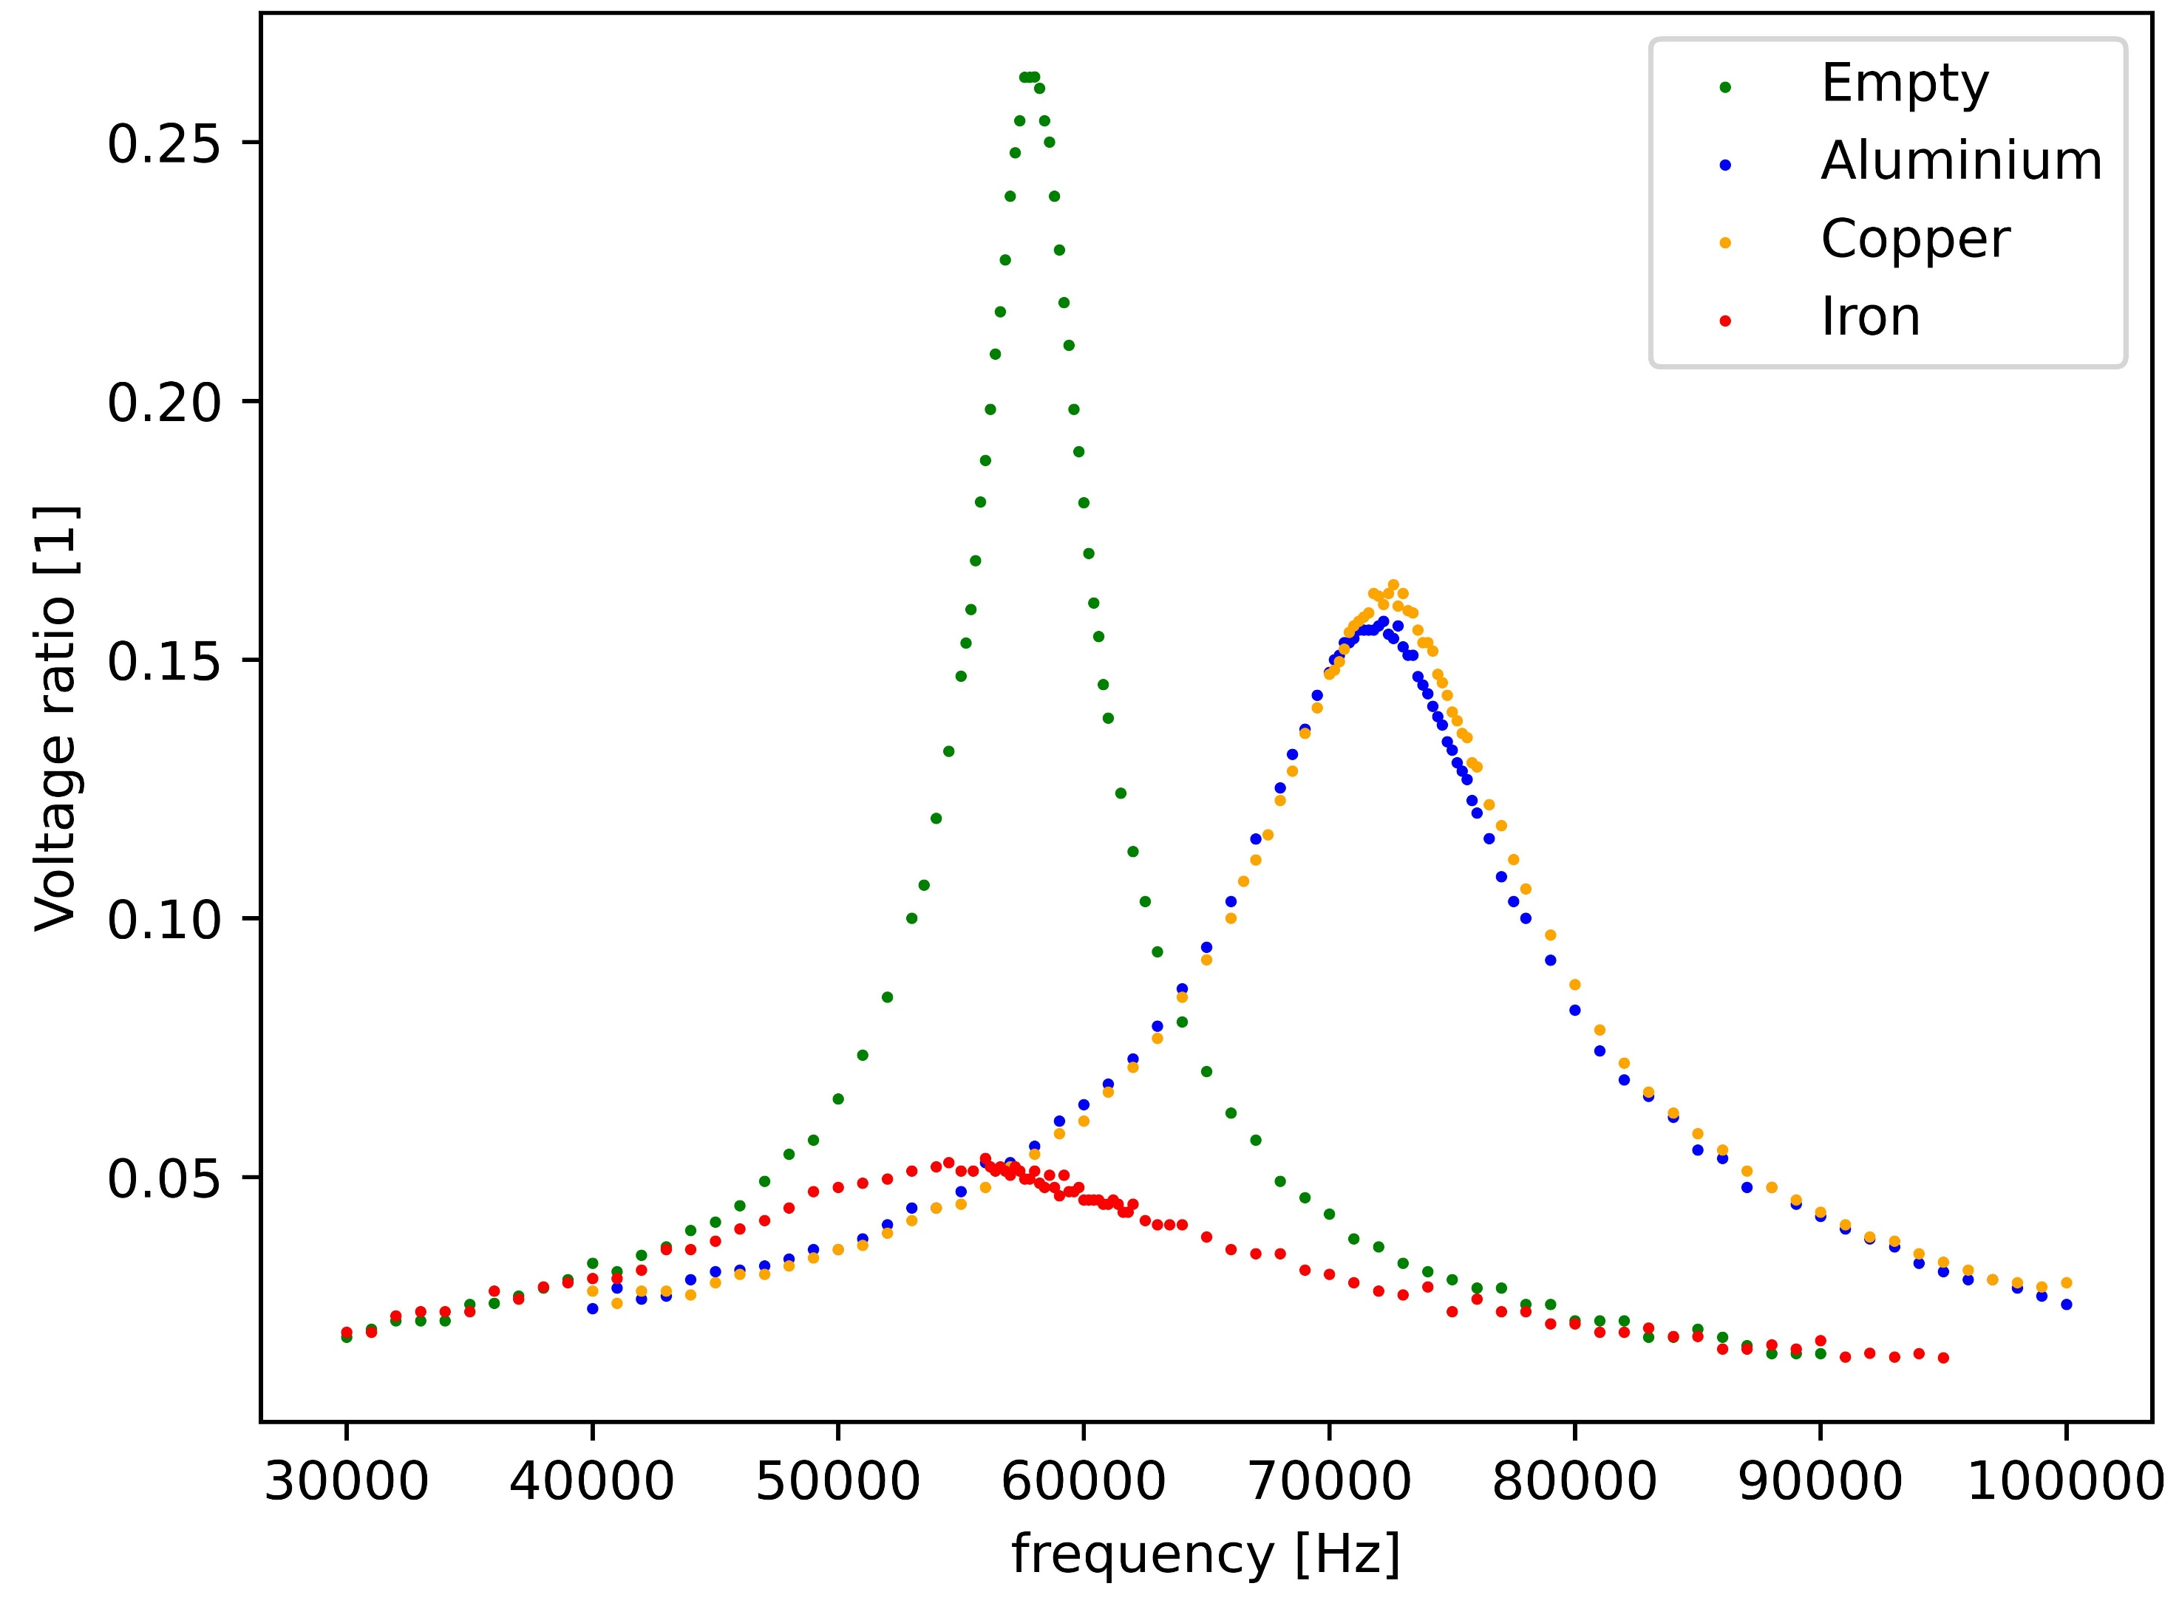
Curves for different materials
Material | Resonance frequency [Hz] | L [H]
Empty | 57 800 | 0,0278
Al | 72 300 | 0,0178
Cu | 72 500 | 0,0177
Fe | 56 200 | 0,0295

Slide 19
How do the properties of the core influence L and R_{L}?

Slide 20
IV. Skin effect

Slide 21
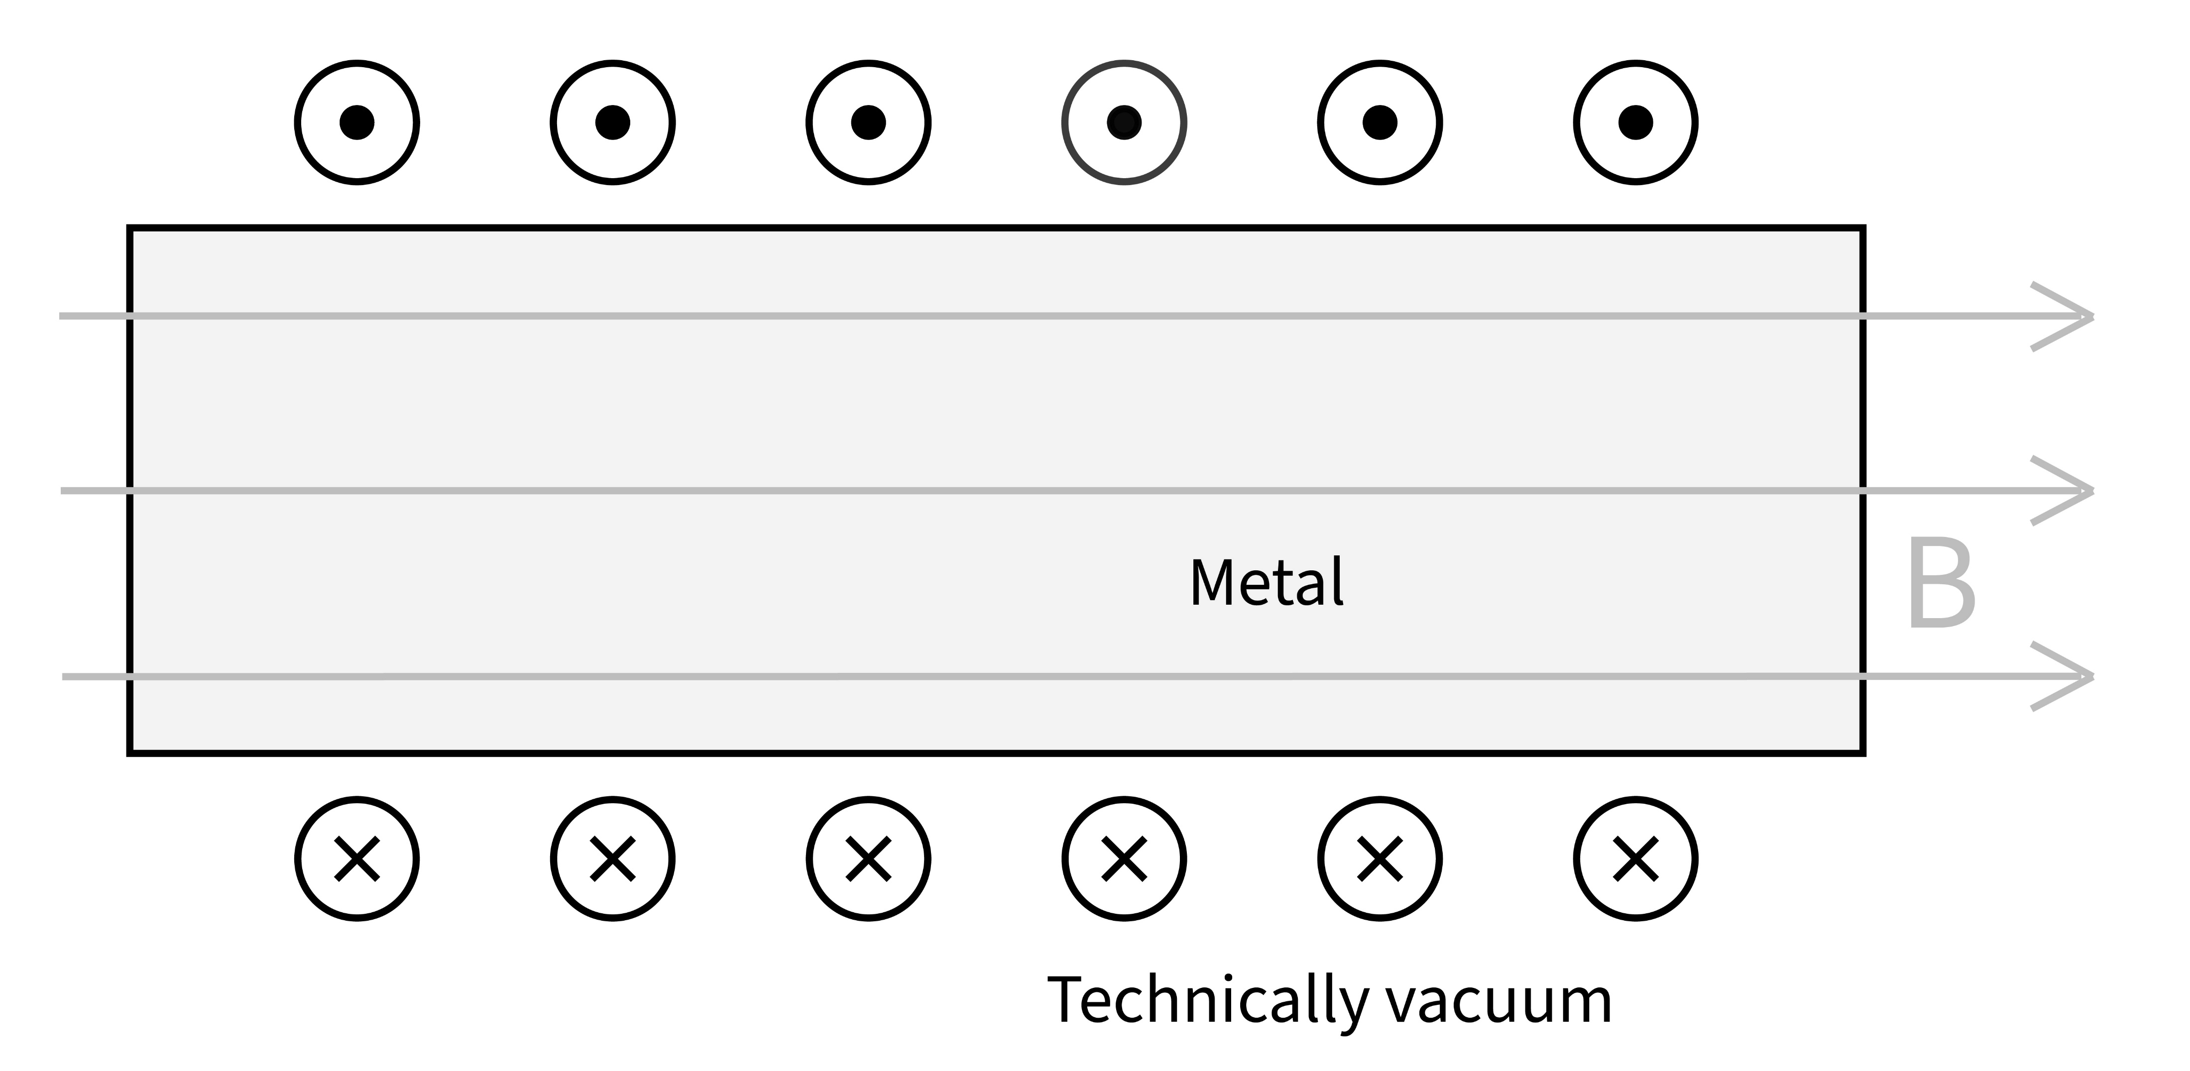
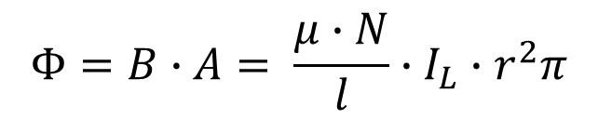
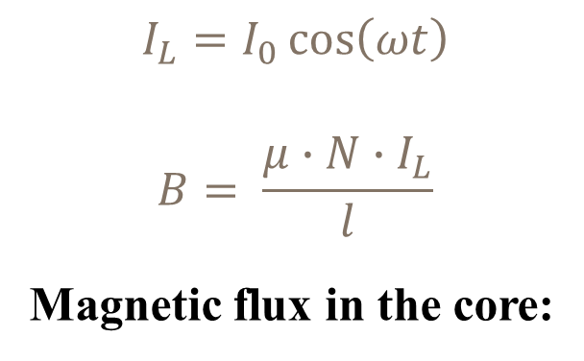
Magnetic field in the coil
(current out)
$$I_{L}=I_{0}\cos\left(ωt\right)$$
$$B= \frac{μ∙N∙I_{L}}{l}$$
Magnetic flux in the core:
$$Φ=B∙A= \frac{μ∙N}{l}∙I_{L}∙r^{2}π$$
(current in)
μ: permeability of rod , A: cross-section of rod

Slide 22
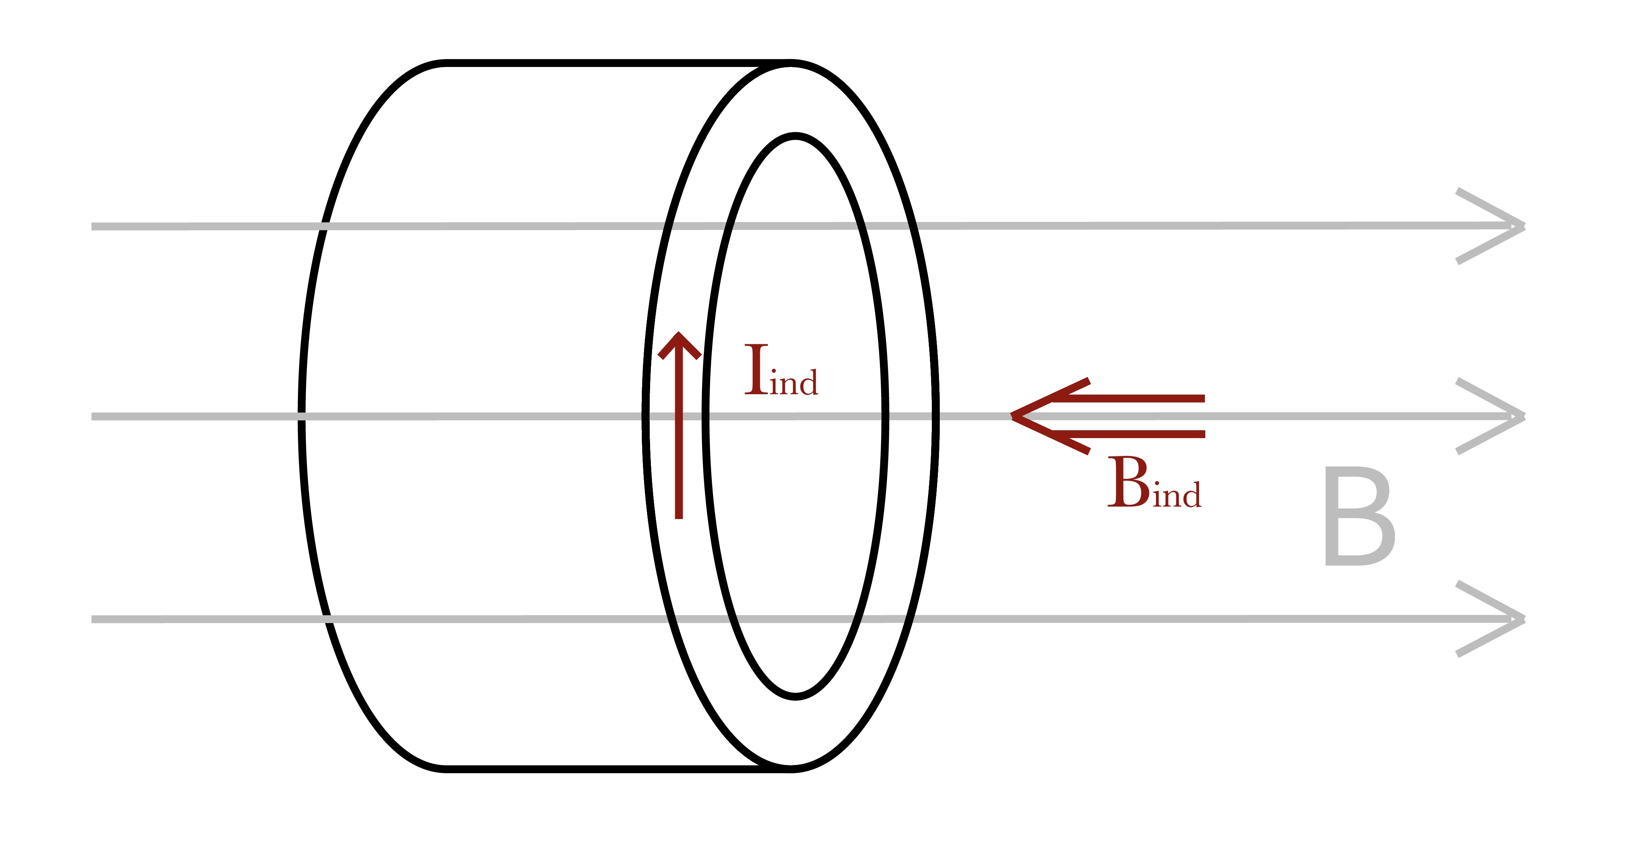
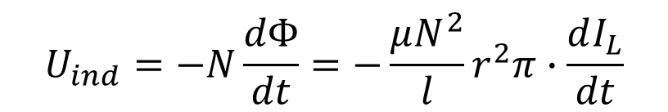
Eddy currents in the core
L
AC source → magnetic field constantly changes
Faraday’s law of induction:
$$U_{ind}=−N\frac{dΦ}{dt}=−\frac{μN^{2}}{l}r^{2}π∙\frac{dI_{L}}{dt}$$
induced Eddy-currents
Lenz’s law → oppose I_{L}
induce opposing magnetic field
concentric currents → B_{ind} is stronger at the center

Slide 23
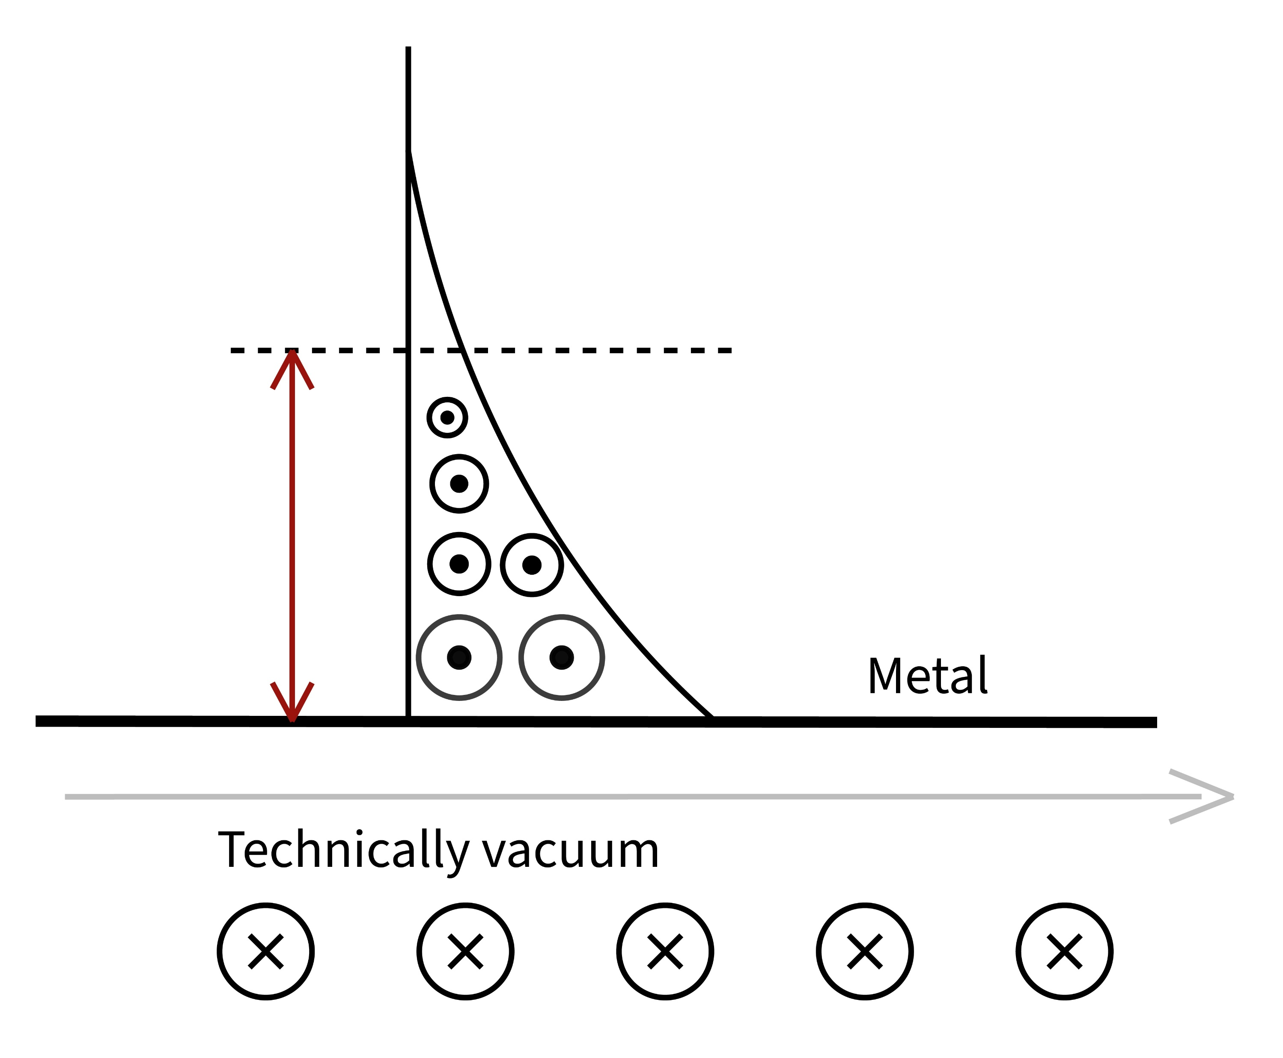
Skin effect
B_{ind} weakens the original B →
total B exponentially decays
magnetic field can only penetrate in the rod until a given distance
opposite Eddy-currents
B = B₀cos(ωt)
Sci-Hub | Formulas for the Skin Effect. Proceedings of the IRE, 30(9), 412–424 | 10.1109/jrproc.1942.232015

Slide 24
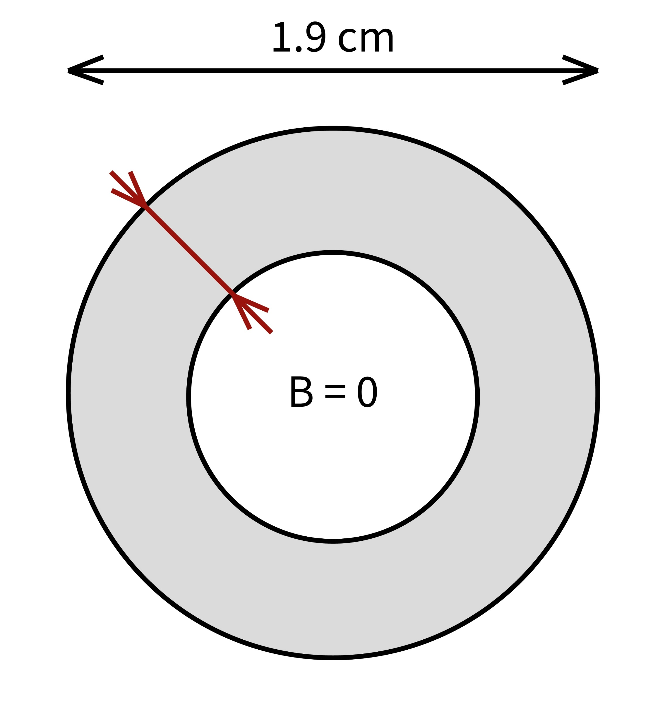
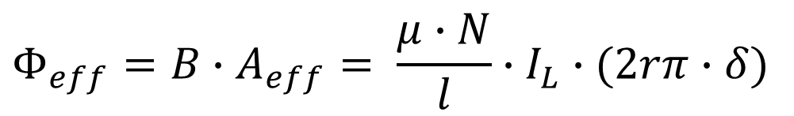
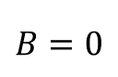





Skin-depth δ
The depth, where current density is $\frac{1}{e}≈37\%$ of the value at the surface
Assumption: the B field outside the skin ring is negligible
Effective magnetic flux:
$$δ=\sqrt{\frac{2}{ωμσ}}=\sqrt{\frac{2ρ}{ωμ}}$$
$$d=2r$$
δ
(for $δ≪r$)
$$B=0$$
$$Φ_{eff}=B∙A_{eff}= \frac{μ∙N}{l}∙I_{L}∙(2rπ∙δ)$$
$$B≠0$$
σ: conductivity of rod ; ρ: resistivity of rod

Slide 25

Skin depth (example)
δ (mm)
Measuring range:
30 000 – 100 000 Hz
Aluminium
Copper
Iron
f (Hz)

Slide 26






Experiments – skin depth
72 500 Hz
72 600 Hz
72 400 Hz
The ratio of voltages and resonance frequency should not change!

Slide 27
Experiment results

Slide 28
V. Inductivity, comparison

Slide 29





Inductivity
$$L_{empty}=\frac{μ_{0}N^{2}r^{2}π}{l}$$
$$N\frac{dΦ}{dt}=L \frac{dI}{dt}$$
(electromagnetic induction)
$$N∙\frac{μ_{0}μ_{r}NI}{l}∙2rπδ=L∙I$$
$$L=\frac{μ_{0}μ_{r}N^{2}2rπδ }{l}=\frac{μ_{0}μ_{r}N^{2}2rπ\sqrt{\frac{2}{ωμ_{0}μ_{r}σ}}}{l}=\frac{2\sqrt{2}πrN^{2}\sqrt{μ_{0}}}{l\sqrt{ω}}∙\sqrt{\frac{μ_{r}}{σ}}$$
$$\frac{μ_{r}}{σ} =\frac{l^{2}L^{2}f}{{πμ_{0}d}^{2}N^{4}}$$
The same ratio can be expressed from the change of resistance of the coil – irrelevant.
Notes:
permeability and conductivity can’t be separated

Slide 30



Electric and magnetic properties
Material | Resonance frequency [Hz] | L [H]
Al | 72 300 | 0,0178
Cu | 72 500 | 0,0177
Fe | 56 200 | 0,0295
Ratio ($μ_{0}/σ)$
$$1,938∙{10}^{−5}$$
$$1,922∙{10}^{−5}$$
$$4,138∙{10}^{−5}$$
$$\frac{μ_{r}}{σ} =\frac{l^{2}L^{2}f}{{πμ_{0}d}^{2}N^{4}}=kL^{2}f\sim \frac{1}{f}∗∗3$$
Constant for the coil:
$$k=8,46∙{10}^{−7}$$
Notes:
A*m / V*s odaírni MÉRTÉKEGYSÉG!!!

Slide 31
Comparison
literature values
measurements
Al Cu Fe
Notes:
mu_r

Slide 32
VII. Summary

Slide 33



Summary
Procedure:
Measure both peak voltages and the phase
Calculate L and R_{L} through curve fitting
Solve the resulting equation system
$${ω_{res}}^{2}\sim \sqrt{\frac{σ}{μ_{r}}}$$
$$\frac{{U_{R}}^{max}}{{U_{T}}^{max}}\sim \sqrt{\frac{σ}{μ_{r}}}$$
$$∆R_{L}=ρ\frac{2rπ∗N^{2}}{δ∗l}$$
$$L=L_{empty}∗\frac{2δ}{r}∗μ_{r}$$

Slide 34






Summary
Thank you for your attention!

Slide 35
Structure
problem statement, basic physics
theory I – RLC circuit
RLC measurement setup
evaluation → L and dR
theory II – Maxwell, obtaining σ and μ
relevant params, prooving skin depth
comparison – limitations
summary – whole process

Slide 36





Appendix – skin effect illustration

Slide 37




Appendix – resistance & currents in the core
I_{L}
$$R=ρ\frac{l_{wire}}{A_{wire}}$$
I_{tube}
$$R_{tube}=ρ\frac{2rπ}{δ∙l}$$
$$I_{tube}=N∙I_{L}$$

Slide 38



Appendix – heat loss
resistance of the wires is constant →
Joule-heating in the core:
$${∆P}_{core}=I_{tube}^{2}∙R_{tube}=I_{L}^{2}∙∆R_{L}$$
$$ρ\frac{2rπ}{δl}∙{\left(NI_{L}\right)}^{2}=I_{L}^{2}∙∆R_{L}$$
$$∆R_{L}=ρ\frac{2rπN^{2}}{δ∙l}=$$
$$R_{tube}=ρ\frac{2rπ}{δ∙l}$$
$$I_{tube}=N∙I_{L}$$
$$∆R_{L}\sim \sqrt{\frac{μ_{r}}{σ}}$$
Notes:
nem az a delta

Slide 39
Appendix – electric and magnetic properties
Material | Relative permeability | Conductivity (S/m , 20°) | Temperature coefficient
Al | 1,000022 | 3,77 e7 | 3,9 e-3
Cu | 0,999994 | 5,96 e7 | 4,04 e-3
Annealed Cu |  | 5,8 e7 | 3,93 e-3
Fe (98% pure) | 5000 - 200000 | 1,03 e7 | 5 e-3
Steel | 100 - 38000 | 1,45 e6 – 6,99 e6
Sources:
Appendix 8: Electrical Conductivity of Selected Materials - An Introduction to Materials Engineering and Science - Wiley Online Library
Electrical resistivity and conductivity – Wikipedia
Permeability (engineeringtoolbox.com)

Slide 40

Appendix – ferromagnetism vs. ferrimagnetism
Ferrite:
Relative permeability: 10 – 20000
very low conductivity
Ferrite | Iron Oxide Compound | Britannica
Ferromagnetism – Wikipedia, Ferrimagnetism – Wikipedia – 1948, Louis Néel

Slide 41
Appendix – sources
2560px-Inductor_symbol.svg.png (2560×640) (wikimedia.org)
capacitor-symbol.jpg (600×200) (wiltronics.com.au)
2560px-Resistor_symbol_Europe.svg.png (2560×1280) (wikimedia.org)
360_F_508722395_Pl3TdrRJjGBqpwcFETTLJf3xlWi9D09I.jpg (360×360) (ftcdn.net)
0 (976×385) (mtstatic.com)

